Slide 1
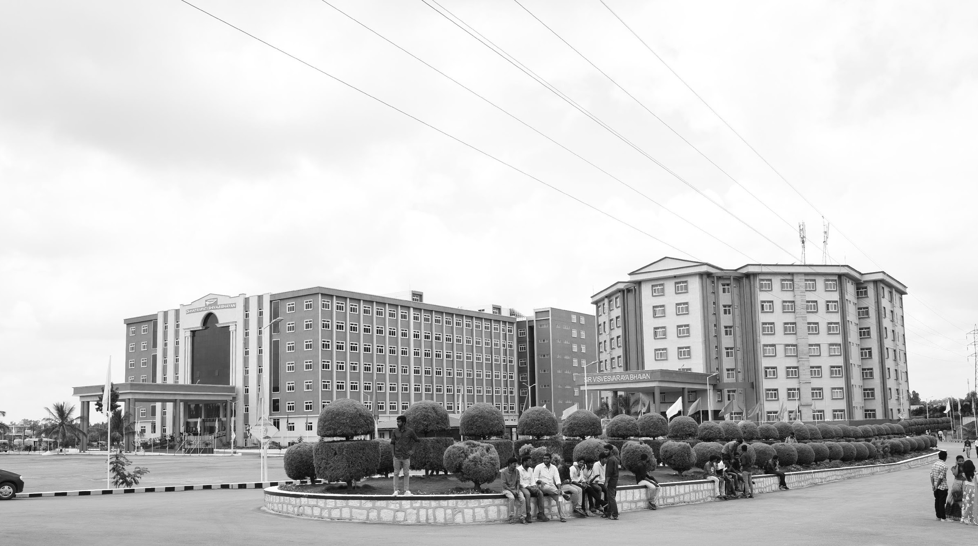

IMAGE BASED BIRD SPECIES IDENTIFICATION
Mid-Review 3
GITAM (Deemed-to-be) University
Major Project
Project ID: A7
AY 2021-25
Department of Electrical Electronics and Communication Engineering
Project Mentor:
Dr.Venkata Kranti B
Project In-charge:
Dr.Pankaj Kandhway
Project Team:
Kaniki Chakradhar Reddy (BU21EECE0100170)
Bulla Yagnesh Reddy (BU21EECE0100198)
www.gitam.edu

Slide 2
Abstract
Bird species identification is crucial for ecological research and conservation, and traditional methods are often time-consuming and subjective. Combining image-based techniques using CNNs for visual recognition and audio-based methods leveraging RNNs for analyzing bird vocalizations offers a more efficient and accurate solution. This dual-modality approach enhances species identification in diverse environments, advancing ecological monitoring and biodiversity conservation efforts. The audio and image-based bird species identification system has several impactful applications. It can aid in ecological monitoring by tracking bird populations and migration patterns, providing valuable data for researchers. In biodiversity conservation, it helps protect endangered species by monitoring their presence in various ecosystems. The system also supports citizen science initiatives by allowing non-experts to participate in species identification. Additionally, it can be used in automated wildlife surveys for large-scale data collection and assist in environmental impact studies to assess how changes in the environment affect bird populations. The audio and image-based bird specics identification system will improve the efficiency of ecological research by automating species classification, saving time and resources. It offers enhanced accuracy through the combination of visual and acoustic data, making it effective in diverse environments. The system will be scalable, allowing researchers and citizen scientists worldwide to contribute to bird monitoring, In the future, real-time monitoring capabilities could provide up-to-date insights on bird populations. Further development could include integration with smart devices and increased adaptability for more species and environmental conditions.

Slide 3
Objective and Goals
Objective
Convolutional Neural Networks (CNNS) for image recognition and Recurrent Neural Networks (RNNS) or Transformer models for audio analysis. The combination of these architectures allows for better accuracy in identifying bird species using multimodal data (audio and image).
Design the system to be scalable for a wide variety of bird species and user-friendly, enabling both experts and casual users to easily identify birds via mobile devices or field sensors.
Develop an intuitive platform that allows users to easily upload audio files and images for quick and accurate species identification through smartphones, computers, or field devices.
Goals
Multimodal Species Identification - Utilize Convolutional Neural Networks (CNNs) for image-based bird recognition..
Scalability & Accessibility - Design a system that is scalable for a wide variety of bird species.
Enhance Data Integrity and Reliability – Implement robust control mechanisms to ensure accurate, secure, and fault-tolerant operations.

Slide 4
Project Plan
Gant Chart - Milestones and Activities
SL.NO | Start Date | End Date | Description
1 | 28-Nov-2024 | 4-Dec-2024 | Continuation of analyzing the problem statement
2 | 7-Dec-2024 | 31-Dec-2024 | Working on the application of the project.
3 | 8-Jan-2025 | 10-Jan-2025 | Review-1
4 | 15-Jan-2025 | 30-Jan-2025 | Implementation of New Methodology
5 | 05-Feb-2025 | 07-Feb-2025 | Review-2
6 | 10-Feb-2025 | 28-Feb-2025 | Writing of the conference paper.
7 | 15-March-2025 | 20-March-2025 | Review=3

Slide 5
Literature Survey
Key Publications
Visualization of audio records for automatic bird species identification, September 2015
Bird Species Recognition using Deep Learning,March 2023
Automated Bird Detection using using Snapshot Ensemble of Deep Learning Models, January 2024
Bird Species detection using Python, march 2024.
Key Resources – Whitepaper| Application Notes | Datasheet| Others
kaggle
Google colab
Existing Implementations – Products| Opensource| GitHub etc
Embedded Memory (RAM: 1-PORT, RAM: 2-PORT, ROM: 1-PORT, and ROM: 2-PORT) User Guide by Intel.

Slide 6
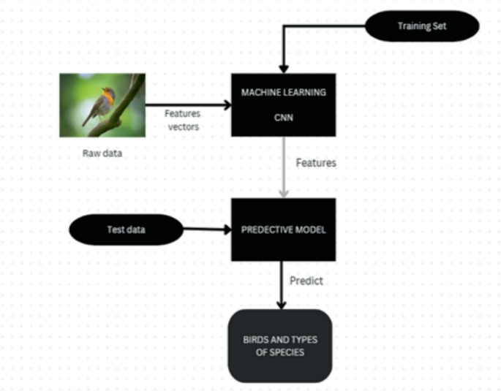
Implementation and Results – Iteration 1
1. Bird Species Identification using image

Slide 7
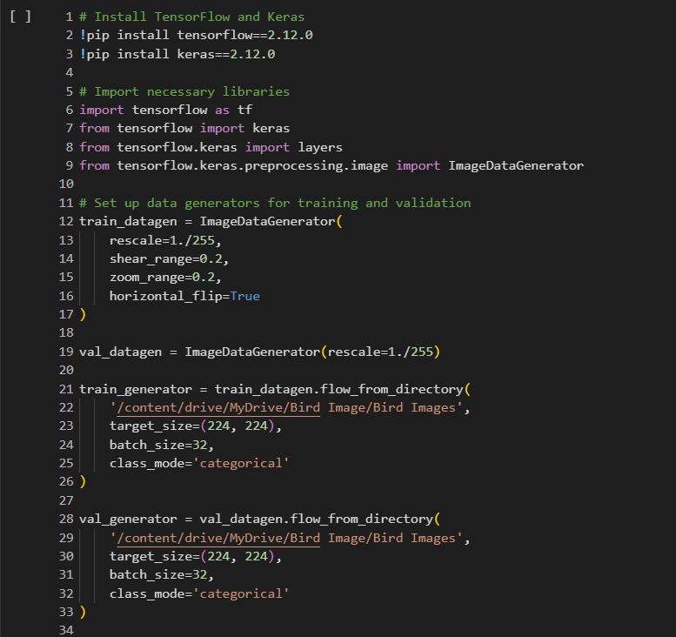
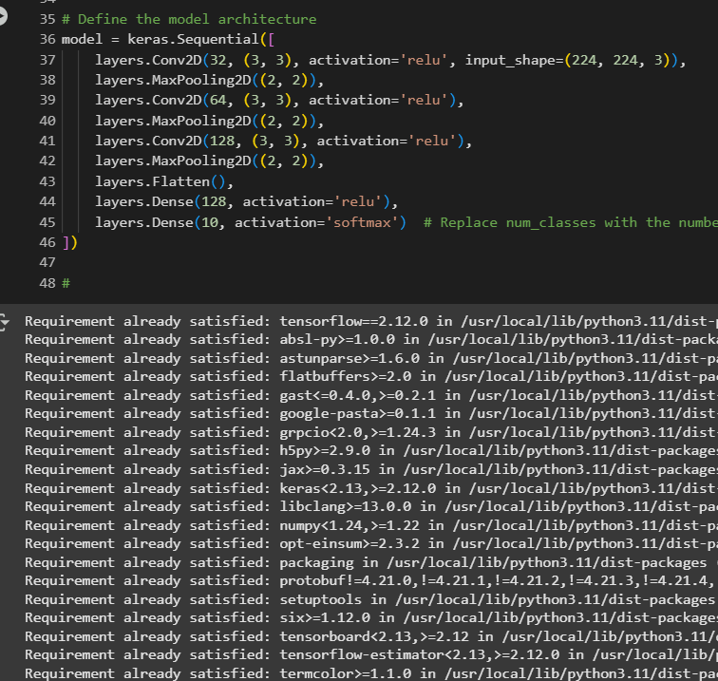

Slide 8
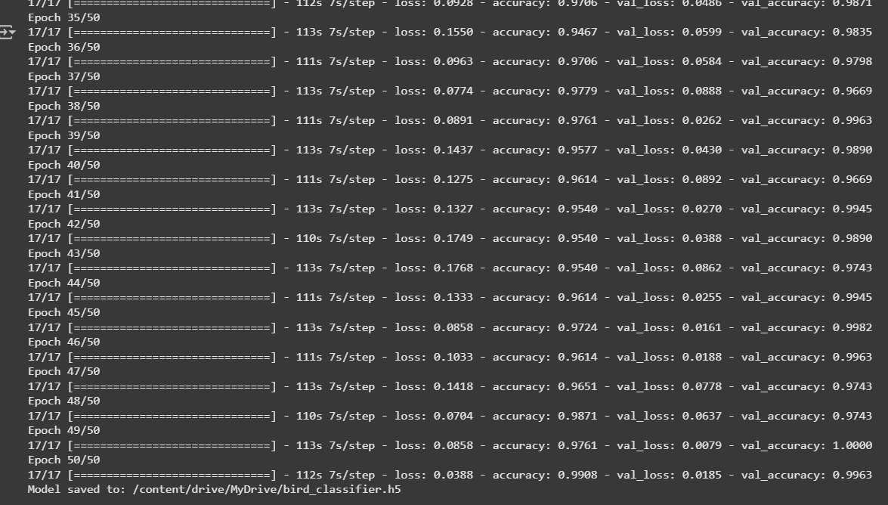

Slide 9
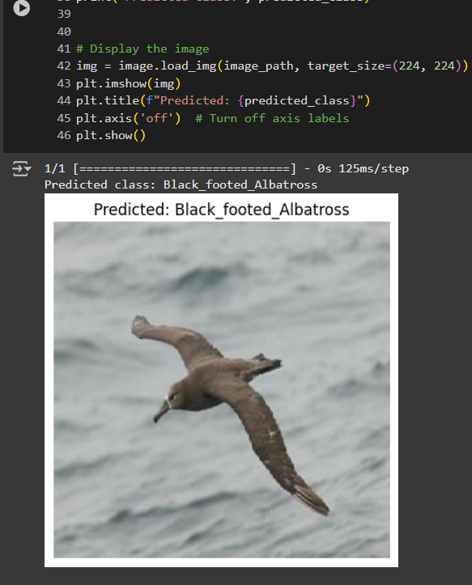
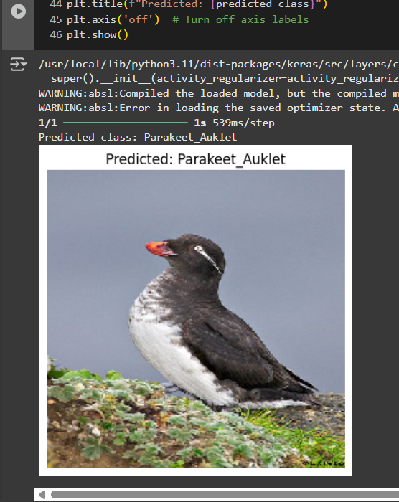
Output

Slide 10
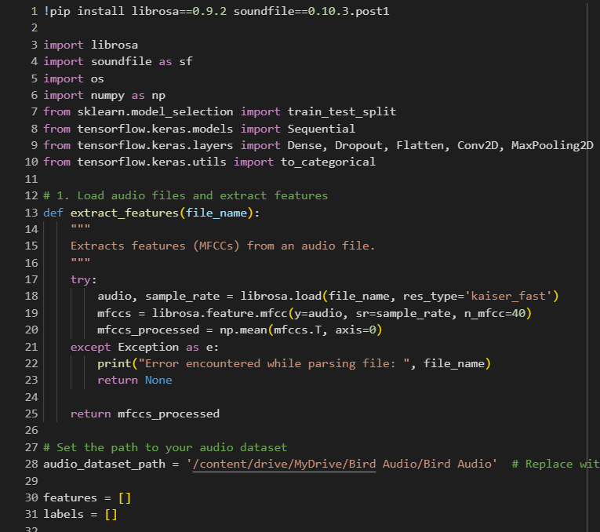
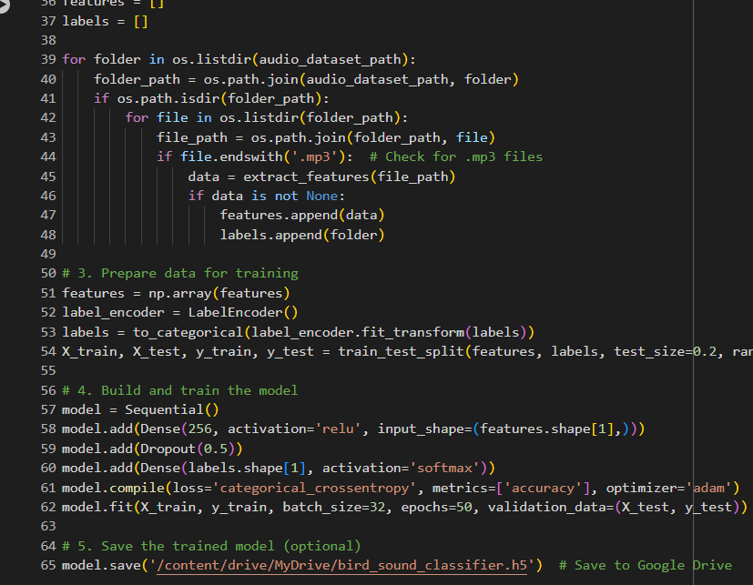
Implementation and Results – Iteration 2
Bird Species Identification Using Audio

Slide 11
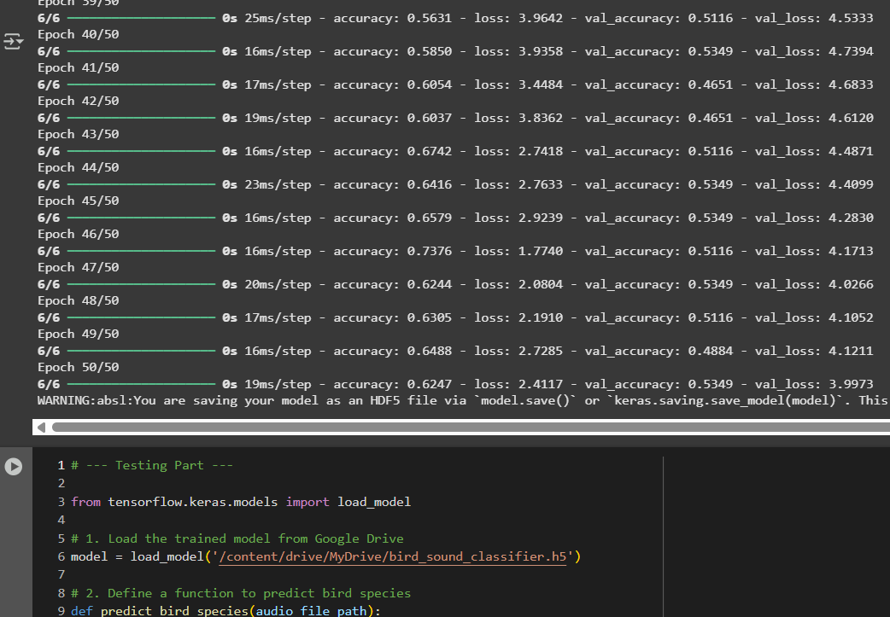

Slide 12
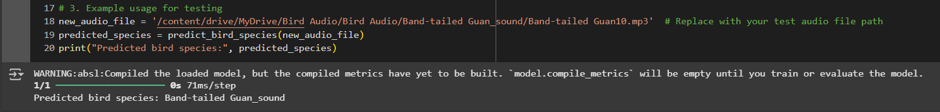
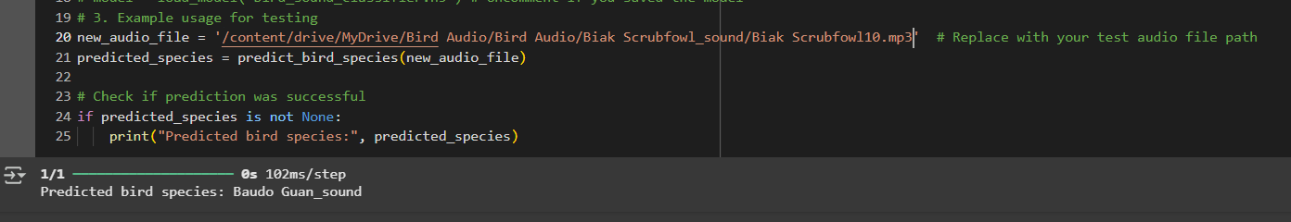
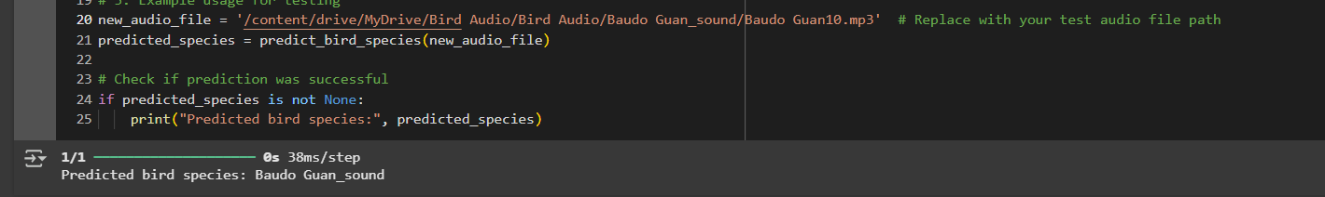
RESULTS

Slide 13
Use Cases & Testing
Test cases:
Visual Accuracy Testing
Goal: Ensure that the generated bird images are visually accurate representations of real bird species.
Diversity and Variation Testing
Goal: Ensure that the generated images cover a wide variety of species, poses, and environmental conditions.
Generalization Testing
Goal: Ensure that the generated bird images can be effectively used for various applications like identification, conservation awareness, or creative design.
Consistency and Realism Testing
Goal: Ensure that generated images are consistent in terms of species-specific features and realistic enough for educational or scientific purposes.
Use Cases:
Data Augmentation for Training AI Models
Purpose: Generate synthetic bird images to augment training datasets for bird species identification models.
Educational Tools and Interactive Platforms
Purpose: Generate realistic images of bird species for educational apps or bird watching tools.
Conservation Awareness and Public Engagement
Purpose: Use generated bird images to raise awareness about threatened species and promote conservation efforts.
Art and Design Applications
Purpose: Generate realistic or stylized bird images for creative and artistic purposes.
Reconstruction of Extinct or Hypothetical Species
Purpose: Generate images of extinct bird species or hypothetical evolutionary outcomes.

Slide 14
Application
Benefits to the Society
1. Conservation and Environmental Monitoring:
Biodiversity Tracking This project can help conservationists monitor biodiversity by identifying and tracking bird species in different ecosystems.
2. Citizen Science and Education:
Develop apps that allow birdwatchers to identify birds in real-time through image and audio recognition. This can engage people in citizen science and help researchers collect data from large-scale observations.
3.Species Distribution Modeling:
The project could be used to create models that predict where certain species of birds are likely to be found based on environmental variables.
4.Invasive Species Detection:
Certain bird species can become invasive, causing disruption to local ecosystems. Identifying and tracking the presence of invasive species can help manage their impact on native wildlife.

Slide 15
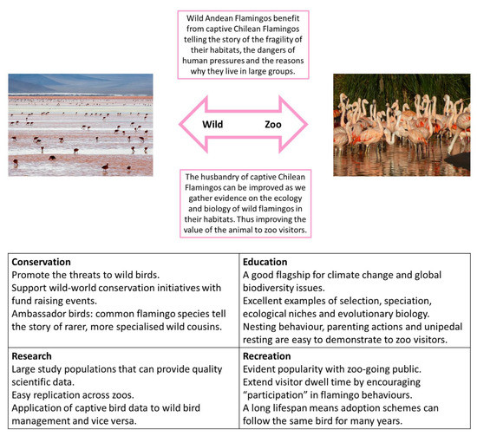
High Accuracy with Transfer Learning
Multi-Modal Identification (Image + Audio)
Real-World Applications
Robust Feature Extraction
User-Friendly and Scalable
Works in Challenging Conditions
Environmental and Educational Benefits
Automated and Efficient
Advantages :

Slide 16
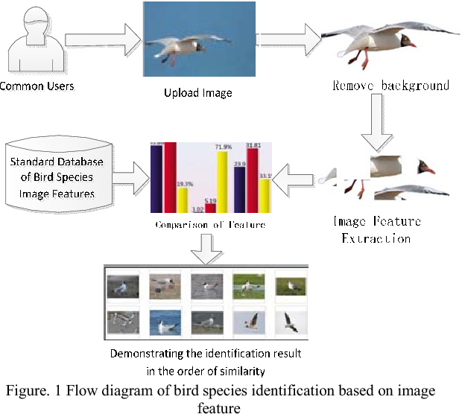
Project Flow:

Slide 17
Advantages :
Real-Time Data Collection: The ability to identify bird species in real-time, whether from images or sounds, provides immediate and up-to-date data on bird populations. This is especially useful for monitoring biodiversity in rapidly changing environments.
Endangered Species Tracking: The project could help identify endangered bird species, enabling better-targeted conservation efforts. By tracking populations of these species, wildlife organizations can work to protect habitats or focus on breeding programs.
Cutting-Edge Research: Your project pushes the boundaries of AI and machine learning by combining both visual and auditory data for species identification. This innovation could lead to further advancements in multi-modal machine learning techniques.
Training Data for Future Models: The data you collect (bird images, sounds, and their respective labels) can contribute to the growing datasets used for training AI systems in other areas of bioacoustics, wildlife conservation, and image recognition.

Slide 18
RESULTS AND DISCUSSION
Image based species Identification

Slide 19
Audio Identification

Slide 20
Conclusion & Future Work
Summary and Conclusion
The main idea behind developing the identification website is to build awareness regarding bird watching, birds and identification.
It also caters to the need of simplifying the bird identification process and thus making bird watching easier.
The technology used in the experimental setup is Convolutional Neural Network (CNN).
The result produced by our project, t has provided 80% accuracy for the prediction of bird species.
Future Work:
Develop an inclusive and user-friendly website ensuring accessibility for all users.
Construct a comprehensive dataset and implement an efficient model for accurate identification.
Develop an intuitive mobile application for species identification with integrated Google search for detailed species information.

Slide 21
Contribution
Team Progress and Movement
Dataset Identification
Sorting of Datasets
Image based Identification
Audio based Identification
Individual Contribution
Key contributions: Bulla Yagnesh Reddy
Implementation
Documentation
Dataset collection
Key contributions: Kaniki Chakradhar Reddy
Documentation
Implementation.
Training dataset

Slide 22
THANK YOU
Have a Great Day !

